Slide 1
Lab 2
Linux User Authentication
* The Lab #2 will be graded.
Notes:
Hello and welcome to today’s lab class. This is Lab 2, and it will be graded.

Slide 2
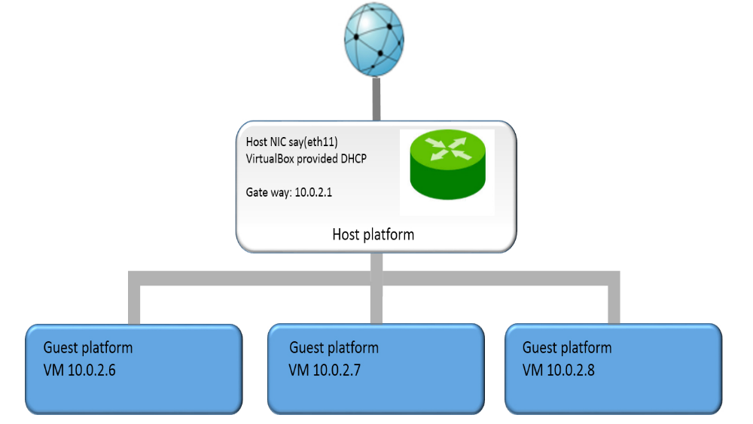



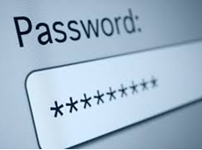
Your Own Cybersecurity Lab Environment
Internet
Your Computer
or
seed
dees
Pre-configured Ubuntu 16.04 Virtual Machines
root
seedubuntu
Notes:
This is Cybersecurity Lab Environment you have built in Lab 1.
For Lab 2, you only need to start one VM.
Please note that the pre-built Ubuntu 16.04 VM comes with two accounts:
username: seed
password: dees
This is a regular user account that you can use for most of your Lab assignments.
username: root
password: seedubuntu

Slide 3
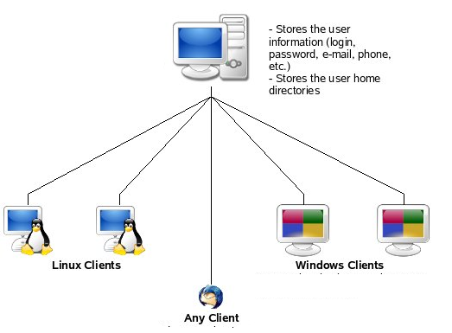
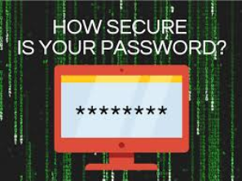
Linux User Authentication
Linux Server
Notes:
Lab 2 will be focusing on user authentication, a very important topic in computer security. Specifically, we will look at today’s Linux user authentication implementation.

Slide 4


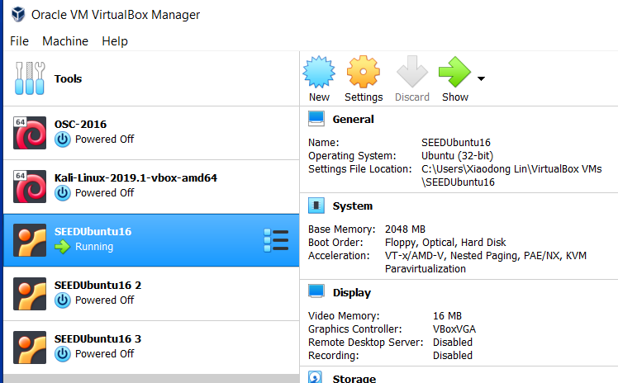
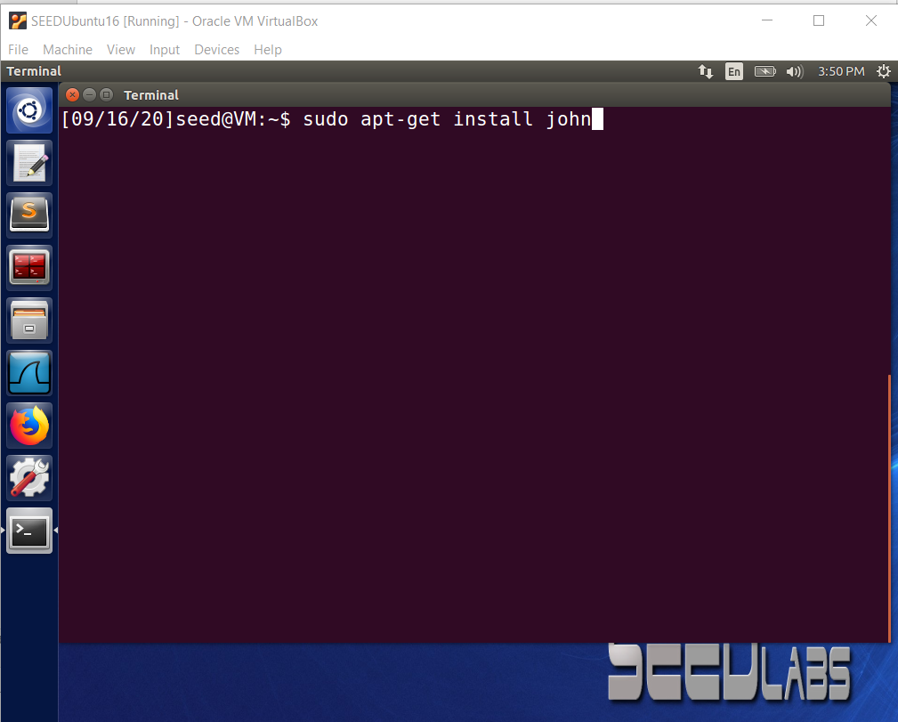
Install John the Ripper
Notes:
For Lab 2, we need a new security tool, particularly, a password cracking tool, called John the Ripper, which is not installed in the VM used in class. You will need to first install it.
Like I mentioned, for Lab 2, you only need to start one VM.
So start one VM and install the John the Ripper and type
sudo apt-get install john

Slide 5
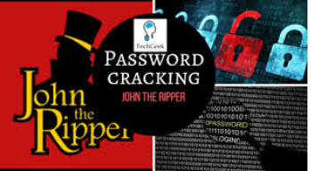
John the Ripper
Open source password cracker from Openwall. It is a fast password cracker, currently available for many flavors of Unix and Windows.
Designed to detect weak passwords
Generates password guesses then compares the guesses against the target password
Source and documentation available on Openwall website
Available in free and community enhanced versions
Website:
http://www.openwall.com/john/
Notes:
What is John the Ripper? It is an open source password cracker from Openwall. It is a fast, very powerful password cracker, currently available for many operating systems including Unix and Windows.

Slide 6
UNIX/Linux User Authentication
6
Notes:
Next, let’s quickly review how UNIX or Linux User Authentication implementations work.

Slide 7
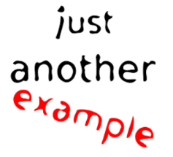
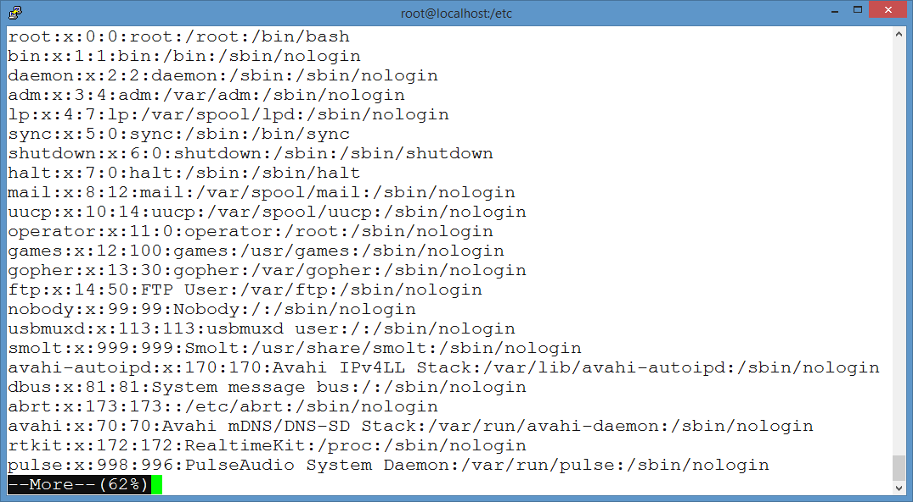
User ID
/etc/passwd
7
Notes:
Unix or Linux employs salted hashed password implementation.
There is a file called "/etc/passwd" in Linux. It is named password, but does not actually store passwords.
Each line in the file contains the login information of a single user on the system.
Each line has seven fields of information, separated by a colon (:) character. The first field is user ID, for example, “root”

Slide 8
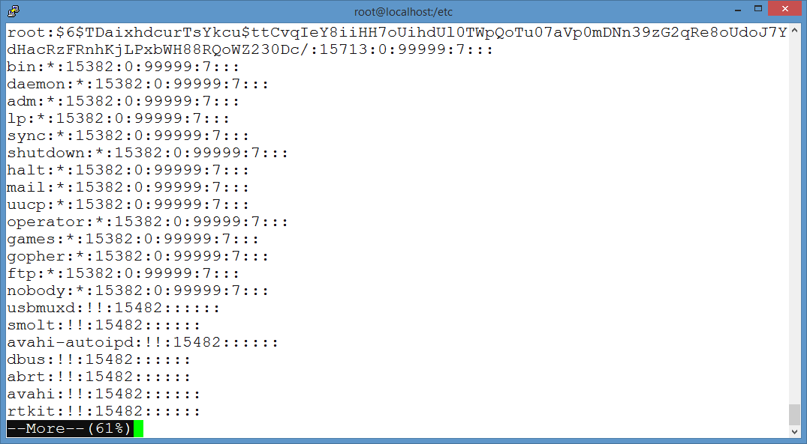
Salted hashed password
/etc/shadow
8
Notes:
There is another file called "/etc/shadow" in Linux.
Each line in the file represents an individual user account, containing a salted hashed password for the user.
Different from the /etc/passwd file, so the "/etc/shadow“ file is readable only by the root user or super user.
Each line has nine fields of information, separated by a colon (:) character. The second field is salted hashed password.

Slide 9
$6$ stands for SHA-512
Password line for root in /etc/shadow
Salt
Compare
Password entered by the user
SHA-512
9
Notes:
Now let us take a look at the Salted hashed password field in more detail. It starts with a dollar sign, and has three fields of information, separated by a dollar sign.
The first field represents the hash function used. $6$ stands for SHA-512
The second field is the salt used here.
The third field is the salted hashed password.
When a user enters his or her password, the operating system uses the user ID (for example, root in this example) to index into the
password file and retrieve the plaintext salt and the hashed password. The salt and user-supplied password are used as input to the hashing algorithm (for example, SHA-512 in this example). If the result matches the stored value, the password is accepted.

Slide 10
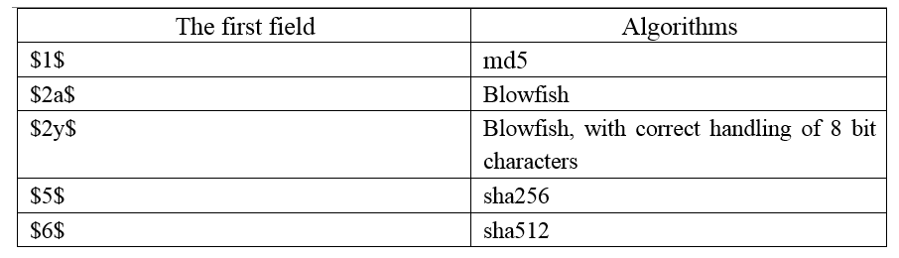
Some common hash functions used in UNIX/Linux User Authentication
10
Notes:
This table shows some common hash functions used in UNIX/Linux User Authentication.

Slide 11
Python code for fun
Password chosen by the user root
[root@localhost home]# python
Python 2.7.3 (default, Apr 30 2012, 21:18:10)
[GCC 4.7.0 20120416 (Red Hat 4.7.0-2)] on linux2
Type "help", "copyright", "credits" or "license" for more information.
>>> import crypt
>>> print crypt.crypt('password', '$6$TDaixhdcurTsYkcu$')
$6$TDaixhdcurTsYkcu$ttCvqIeY8iiHH7oUihdUl0TWpQoTu07aVp0mDNn39zG2qRe8oUdoJ7YdHacRzFRnhKjLPxbWH88RQoWZ230Dc/
>>> exit()
[root@localhost home]#
11
Notes:
Next, let’s have fun with some python code. If you give the password and the salt value and specify the hash function in Slide 9, as the arguments to the crypt() function in the crypt module, you will obtain the same Salted hashed password. Bingo!

Slide 12


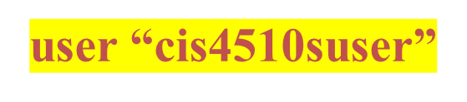
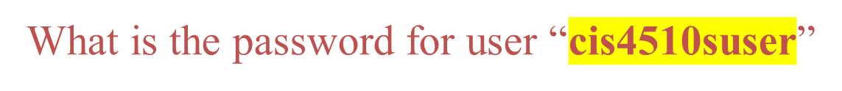



abc1 abc2 abc3 abc4 abc5 abc6 abc7 abc8 abc9 abc10
1) Password Cracking
12
Notes:
Now, you are ready to practice some password cracking skills. First, you will need to crack the password used by user “cis4510suser”.
Suppose you know the user uses one of ten passwords listed here.
However, you are NOT allowed to try all 10 passwords one by one on the real system directly.
It will fail since a user account will be locked if there are many failed login attempts.

Slide 13

cis4510suser:$6$PZOyfkQz$C8Rj2dcT2kjTHKYDJDzCMJ7GpJeklx7pafQjyONMdMqcBAeqcW/tDfEBOPczx7VdCF70E5CgXsG4krDZBjkmv0:17551:0:99999:7:::
Linux server compromised
13
Notes:
We assume that you have compromised the Linux system where the user “cis4510suser” belongs to. Particularly, you are able to gain access to the /etc/shadow file. The line for the user “cis4510suser” is shown here

Slide 14

What is your method to find the correct password of user “cis4510suser”? Your method should successfully discover the correct password but without any need of guessing passwords to the system. (HINT: you can reuse the Python code snippet shown in Slide 11 or Figure 1 in lab sheet to crack the password of the user “cis4510suser”.)
What is the password for user “cis4510suser”?
14
Notes:
Your first mission is to figure out a method or algorithm to find out the correct password of user “cis4510suser”. And, what is the password for user “cis4510suser”?

Slide 15
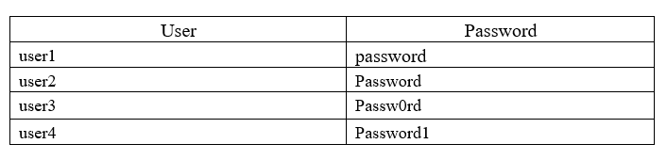
2) Unix Password Hashes Cracking using John the Ripper
Create the following new usernames as well as and their corresponding passwords using the useradd and passwd commands
15
Notes:
The second task in Lab 2 is get you familiar with John the Ripper.
So you first create four new users with the names and their corresponding passwords in the table here using the useradd and passwd commands

Slide 16
2) Unix Password Hashes Cracking using John the Ripper (cont’d)
Cracking Passwords with John the Ripper, for example, crack the password of user user1
First, you need to generate a password file user1.txt for user user1, for example,
sudo grep user1 /etc/shadow > user1.txt
Then, you use John the Ripper to crack the password of user user1, john user1.txt
Give it time to see how long it takes for the password to be cracked, and then record the time. Note that if a password hasn’t been cracked after 5 minutes, you simply force John the Ripper to exit by “Ctrl+c” and record the time as “Not cracked”.
16
Notes:
Then, crack passwords with John the Ripper, for example, crack the password of user user1
First, you need to generate a password file user1.txt for user user1, for example, type
sudo grep user1 /etc/shadow > user1.txt
Please note that Don't work on the /etc/shadow directly.
Then, you use John the Ripper to crack the password of user user1, and type
john user1.txt
Give it time to see how long it takes for the password to be cracked, and then record the time.
Note that if a password hasn’t been cracked after 5 minutes, you simply force John the Ripper to exit by “Ctrl+c” and record the time as “Not cracked”.

Slide 17
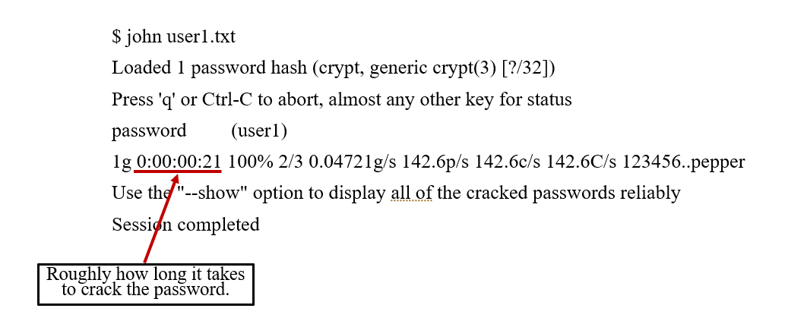
2) Unix Password Hashes Cracking using John the Ripper (cont’d)
17
Notes:
This slide shows an example output of John the Ripper. It can be observed that it is a very quick to crack a simple password. For example, it only takes roughly 21 seconds to crack this password.

Slide 18

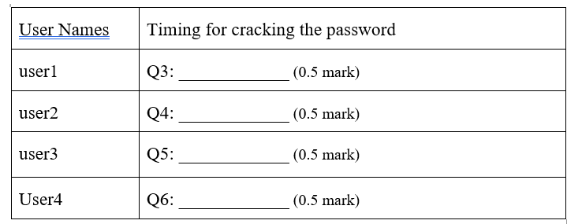

2) Unix Password Hashes Cracking using John the Ripper (cont’d)
Reflection question
In your opinion, which password is the most complex one, password, Password, Passw0rd or Password1? Did you notice a correlation between the times it took to crack a password versus the complexity of the password? You should have seen that more complex passwords take longer to recover.
18
Notes:
Record the time of how long it takes to crack the password of each user.
Also, answer the reflection question:
In your opinion, which password is the most complex one, password, Password, Passw0rd or Password1? Did you notice a correlation between the times it took to crack a password versus the complexity of the password? You should have seen that more complex passwords take longer to recover.

Slide 19
2) Unix Password Hashes Cracking using John the Ripper (cont’d)
Using John the ripper, try to break the passwords in the passwords.txt file provided.
What passwords were you able to crack?
19
Notes:
You are provided with a password file called passwords.txt. Next, using John the ripper, try to break the passwords in the passwords.txt file provided.
What passwords were you able to crack?

Slide 20
3) Cracking the password in Q1 using John the Ripper
cis4510suser:$6$PZOyfkQz$C8Rj2dcT2kjTHKYDJDzCMJ7GpJeklx7pafQjyONMdMqcBAeqcW/tDfEBOPczx7VdCF70E5CgXsG4krDZBjkmv0:17551:0:99999:7:::
Clearly describe what you do to use John the Ripper to crack the password of user “cis4510suser”?
Does John the Ripper successfully crack the password for user “cis4510suser”?
20
Notes:
In the third task, you are asked to use John the Ripper to crack the password in Q1.
You will need to figure out the answers for two questions:
Clearly describe the steps or what you do to use John the Ripper to crack the password of user “cis4510suser”?
Does John the Ripper successfully crack the password for user “cis4510suser”?

Slide 21
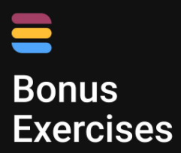
Suppose you are now able to obtain the line for the user “mctisuser” in the /etc/shadow file on a Linux system, which is shown below
mctiuser: $6$wDRrWCQz$QaU0lsixlFkIojWVbSPwkn.ZRex1f.H089auCQjEsnZu0Nnm.HV/yCQ74sxYU2yGBO75Y0uZVZN6Lnn/RxQUV1:17372:0:99999:7:::
Now you only know that the length of the password used by the user “mctiuser” is 4 letters (all lowercase). What is the password for user “mctisuser”?
21
Notes:
Finally, I have a bonus question for you. Please note that you are not required to complete these bonus exercises but you are strongly encouraged to try them. Doing so can yield you some bonus points for the final grade of the course. For this question, you will also need to develop your own python program to crack the password.
Suppose you are now able to obtain the line for the user “mctisuser” in the /etc/shadow file on a Linux system, which is shown here.
The only knowledge you have collected about the user “mctiuser” is the length of the password used by the user is 4 letters (all lowercase). What is the password for user “mctisuser”?

Slide 22

After finishing lab #2, you can build a password cracking tool, which could be even better than John the Ripper. Right?
22
Notes:
After finishing lab #2, I believe you can build a password cracking tool, which could be even better than John the Ripper. Right?

